Slide 1
ATTENDANCE CAPTURE SYSTEM USING FACE RECOGNITION
By
P.Mounika Devi
VP21CSCI0200101
M.Sc. Data Science(Section-B)
Under the Guidance of
Prof.N.Anusha
Dept. of Computer Science
GITAM School of Science
GITAM ( Deemed to be University)

Slide 2
Contents
Introduction
Problem Statement
Aim
Objective of the project
Existing System
Proposed system
Advantages
Proposed Model
Flow chart
Modules
Technologies and Languages used to Develop

Slide 3
Introduction
For every organization, today attendance is the most important thing to record the presence of someone. The presence of someone in an organization is a sign that the person is carrying out their obligations to come to the agency or organization. Usually, attendance is done manually. It can be signed or called one by one. In this digital age, there AQ1 must be a change from this absence to be able to accelerate and provide time eﬃciency. We can use face recognition to record attendance from everyone present in an organization. In this face recognition, many algo-rithms are performed to dissect and capture images of someone’s face,such as Machine Learning and Deep Learning. With this algorithm, the system can recognize a person’s face and record attendance from that person so that attendance activities are more eﬃcient and faster.

Slide 4
Problem Statement
Most of the colleges or industrial sector they use either manual attendance or biometric system so in manual system here they can perform malpractice and it is time consuming to take the attendance

Slide 5
Aim
To develop an tool witch can take the attendance in one single click and more accurate

Slide 6
Objective of the project
To develop an tool which can take the class room attendance using multiface ATTENDANCE SYSTEM

Slide 7
Existing System
An automated attendance system based on face recognition is a biometric system where typically, it registers the attendance of each student present in a class by detecting and identifying all of their faces, and then this recorded information is ideally transmitted to a server device which may compute the attendance of each student and store and update the corresponding data in a database. Automated attendance systems are more reliable, rigid, and eﬃcient than the traditional attendance systems and other biometric attendance systems,leading to better productivity and output of both the teachers and students, as well as better consumption of time.

Slide 8
Proposed system
This uses the method of a systematic PRISMA review. By using this PRISMA method we can get focus reports from various researches. This method helps in making to review attendance technology using facial recognition. Figure 1 is a ﬂow diagram report from the amount of research, journals, and articles used in this paper.here in the proposed system we implement yolo framework an deep learning tehnique to work with more accurate in attendance posting

Slide 9
Advantages
1) High accuracy
2) High efficiency

Slide 10
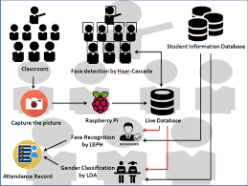
PROPOSED MODEL

Slide 11
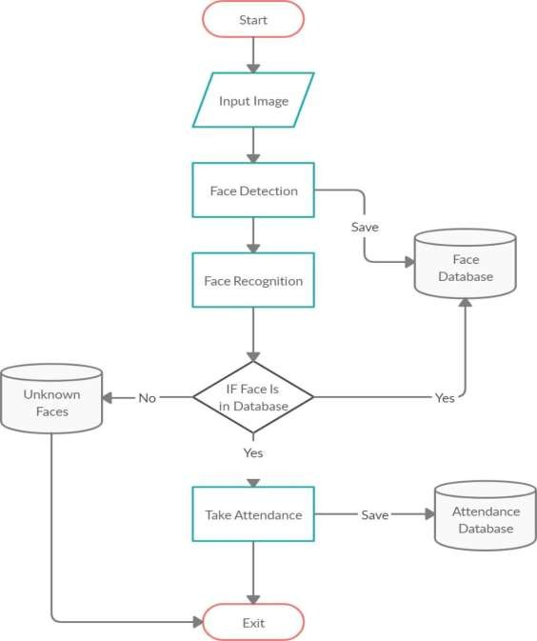
Flow chart

Slide 12
Modules
The facial recognition system has three main phases, which are described below:
Face Detection
Face detection is the ability to identify the person’s faces with in the digital images. This system identifies the human face present in an image or video. We need to define a general structure of a face to determine certain picture or 4 video contains a face (or several). Human faces have the same features such as eyes, nose, forehead, mouth, and chin. Therefore, the objective of face detection is to find the location and size of the face in an image. The located face is then used by the facial recognition algorithm.
Face Recognition
Face Recognition is being able to uniquely identify and verify a person’s face by comparing and analyzing a biometrics person’s face. A face recognition system is an application that is used for identifying or verifying a person from a digital image

Slide 13
Technologies and Languages used to Develop
Python
Debugger and Emulator
Any Browser (Particularly Chrome)
Hardware Requirements
For developing the application the following are the Hardware Requirements:
Processor: Pentium IV or higher
RAM: 8gb
Space on Hard Disk: minimum 40gb

Slide 14
Thank You

